Slide 1





BLEND TO BENEFIT
FITTING OF MIXTURE DISTRIBUTION ON MOTOR INSURANCES
GROUP MEMBERS
MENTOR
ROHAN SHAH
AASTHA SHARMA
Dr. Pradnya Khandeparkar
VERNI SHARMA
ANSHIKA SHARMA
ANIRUDDHA SHELKE

Slide 2
Acknowledgement
The realization of any achievement necessitates the concerted labor and dedication of numerous individuals. The endeavor at hand, our project work, is no exception. Our profound appreciation extends to Dr. Pradnya Khandeparkar, whose inspiration and guidance have been instrumental in steering our efforts towards the successful execution of this research project.
We express our sincere gratitude to NMIMS for affording us the invaluable opportunity to undertake and conduct this research project. The support and resources provided by NMIMS have played a pivotal role in facilitating the progression and completion of our scholarly endeavors.

Slide 3
1
Background
2
Introduction and Objective
3
Data Description-Dimension
Table of Contents
4
Exploratory Data Analysis
5
Methodology
6
Results
7
Inferences
8
Limitations & Future Scope
9
References

Slide 4


Objective
To Study Motor Insurance Claims and investigate its underlying distribution(s)

Slide 5
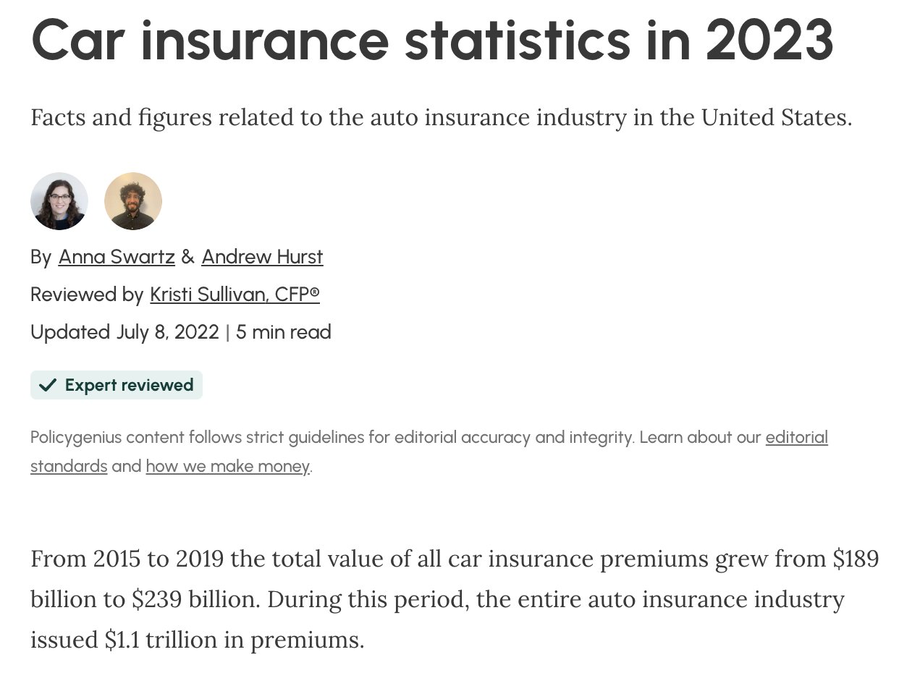




Background
Why Insurance? Why Motor Insurance?
As per 2018,
Motor Insurance was the best performing non-life insurance segment in India with gross direct premiums of INR 59,246.11 crore.
According to the Indian insurance regulator, the motor insurance business reported a growth rate of 8.91% to take a share of 38.08% of the total general insurance business in India in 2018-19.
Research in this field can contribute
to a better understanding of risk management,
financial stability, and economic resilience.
Insurance industry plays a crucial role in
Legal Requirement
Financial Protection
Medical Coverage
Asset Protection

Slide 6

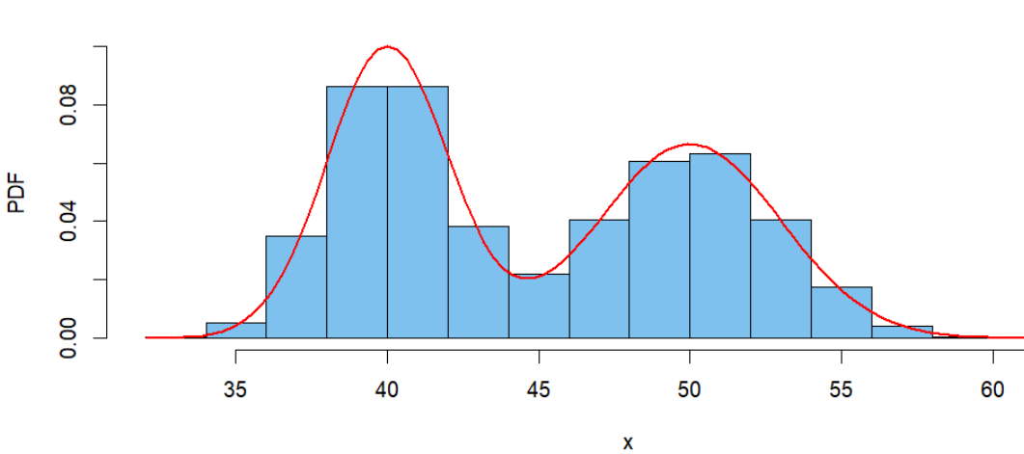
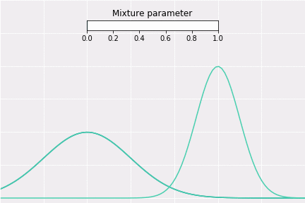
What is a Mixture Distribution?
A mixture distribution is a statistical distribution that is composed of a mixture of two or more component distributions. Each component distribution is associated with a certain probability, and the overall probability distribution is a weighted sum (or mixture) of these components.
πi ’s are the weights
fi(x)’s are the distributions of the individual components
i goes from 1 to k.
GMM-Gaussian Mixture
Common Examples!
Binomial Mixture
Common Domains
Clustering
Density
Time Series
Analysis
Speech & Audio
Processing
Finance

Slide 7
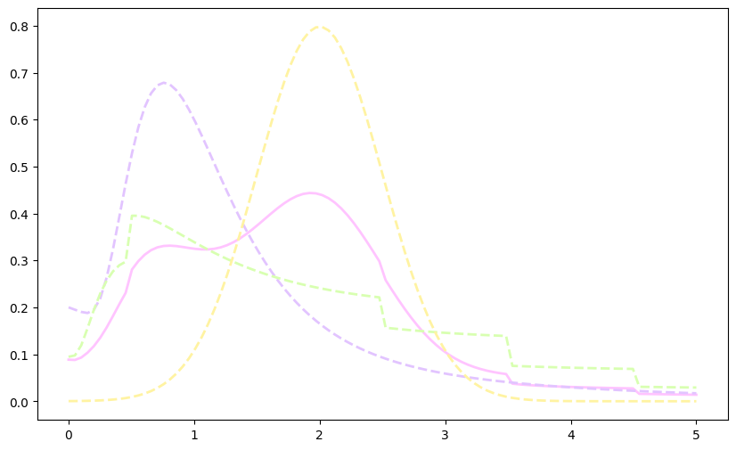
Why Mixture Distribution On Claims?
1. Handling Skewed or Non-Normal Distributions:
Claims data are often skewed or non-normal distributions. Mixture models, especially GMMs, are capable of capturing a wide range of distribution shapes, asking them suitable for handling diverse claims data
2. Heterogeneity in Claims Data:
Claims data often exhibits heterogeneity, means that it may come from different underlying distributions. Mixture models can capture this heterogeneity by representing the data as a combination of multiple distributions.
3. Modeling Complex Distributions:
Claims data may not be easily characterized by a single probability distribution. Mixture models provide a flexible framework for approximating complex data distributions by combining simpler component distributions
4. Fraud Detection:
Mixture models can be used for fraud detection in insurance claims. By modeling the normal and abnormal behavior separately, anomalies can be detected more effectively.
5. Predictive Modeling:
Mixture models are useful for predictive modeling in insurance, helping companies anticipate future claim patterns and identify potential risks. This is particularly valuable for strategic planning and resource allocation

Slide 8


Data Description
Kaggle.
Data was obtained from
Variables of interest
Total Claim Amount (USD)
Pre processing
No missing values were found in our data
Some columns that were irrelevant to our study or found to be ambiguous were removed (“hobbies of insured” , “Capital Gains”)
Data was found to be proportionate (in terms of sex, education level or state variables )

Slide 9
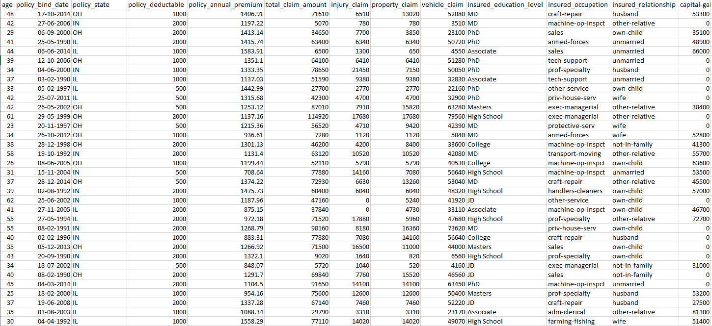
Snapshot of data
DIMENSIONS : 1000 X 31

Slide 10
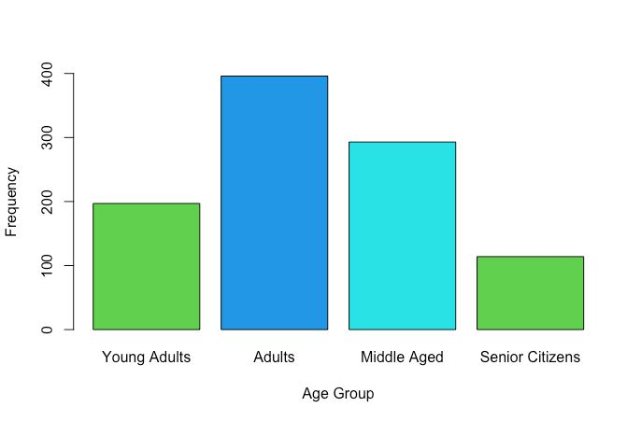
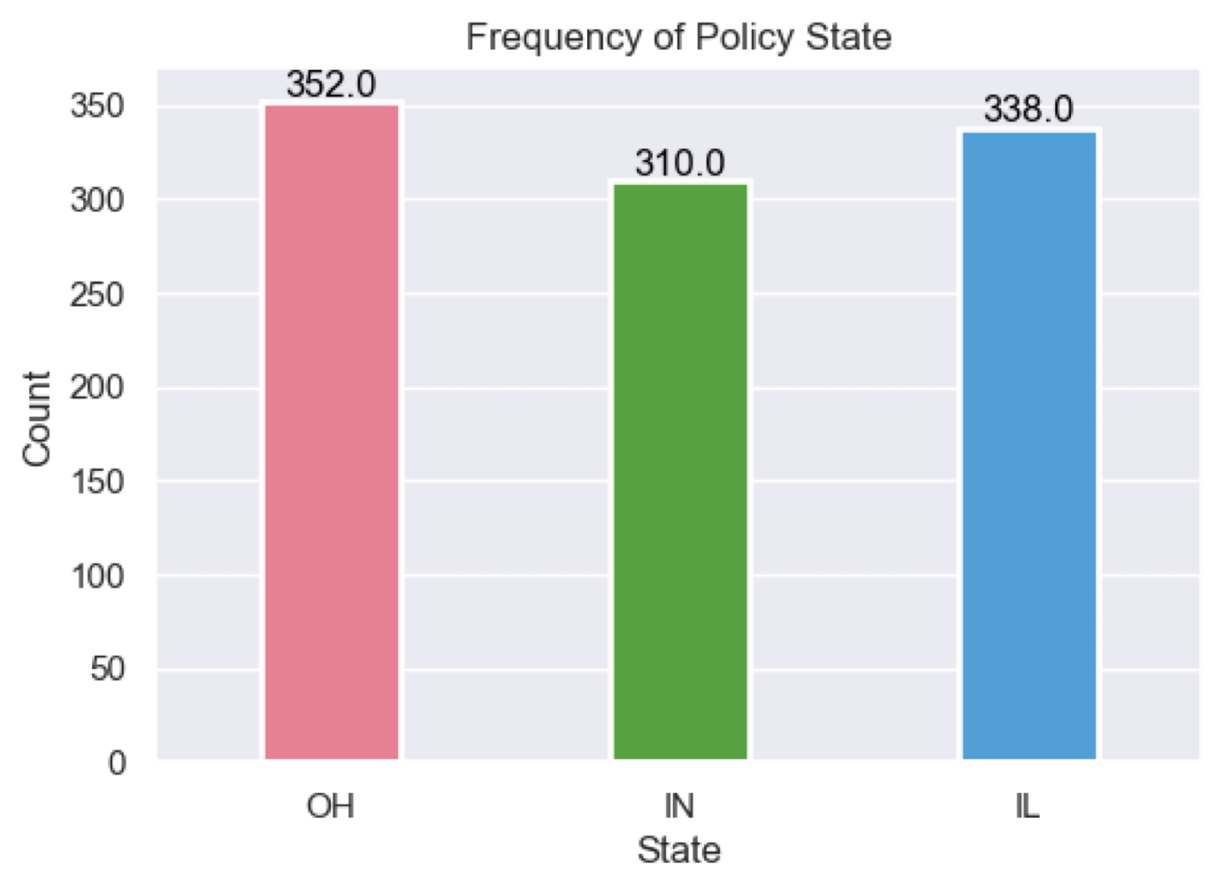
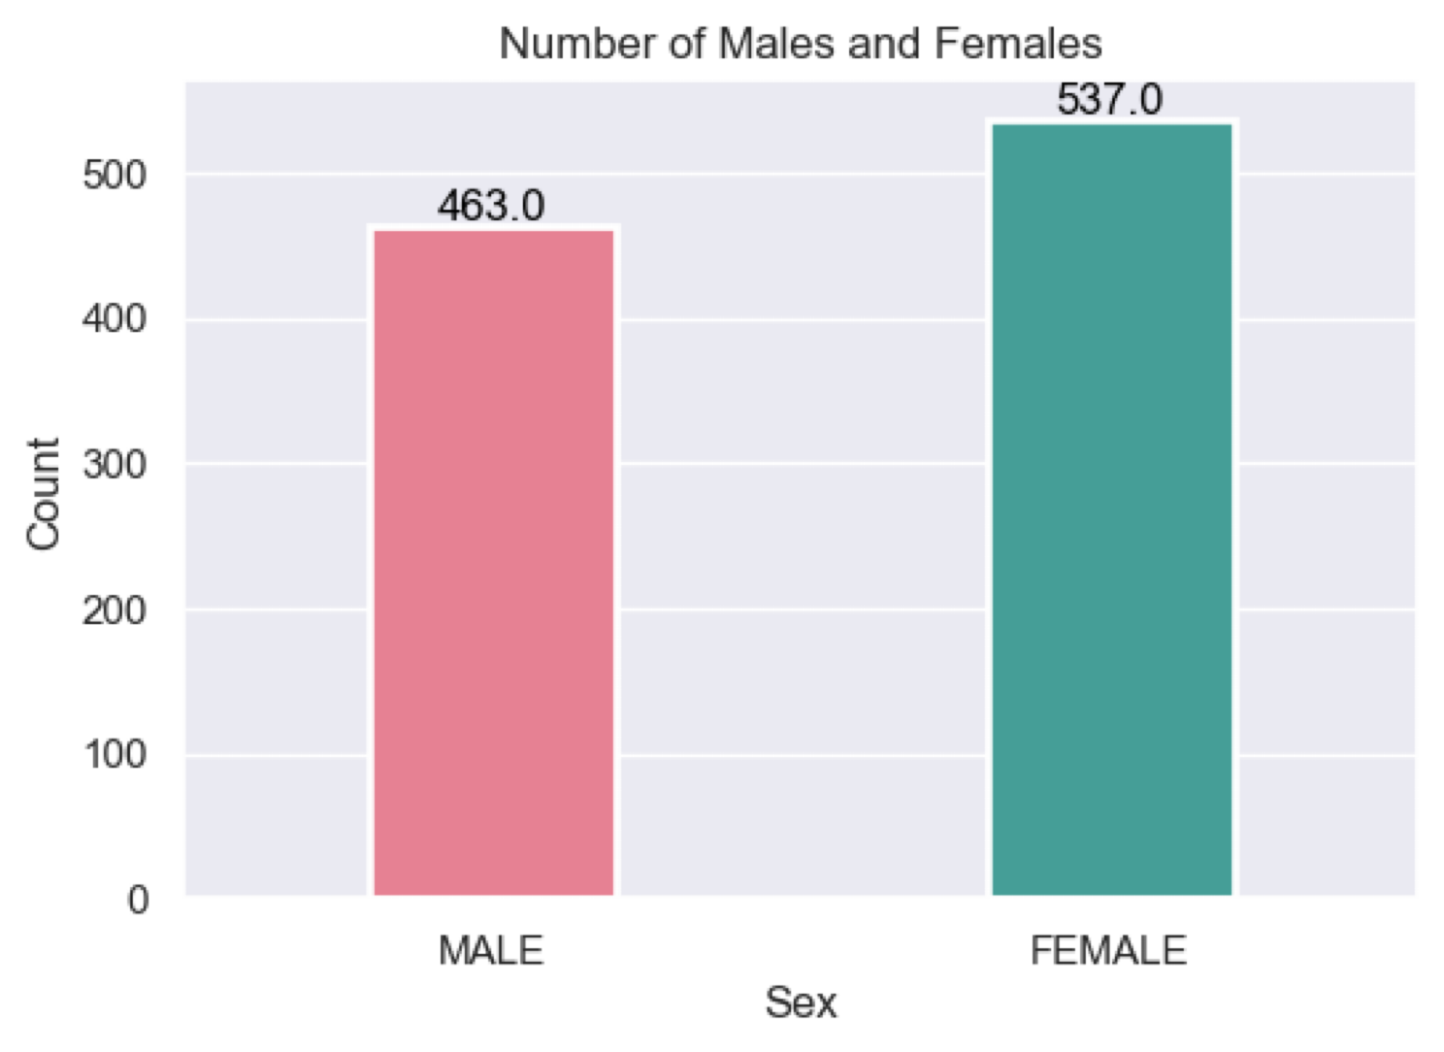
EDA

Slide 11

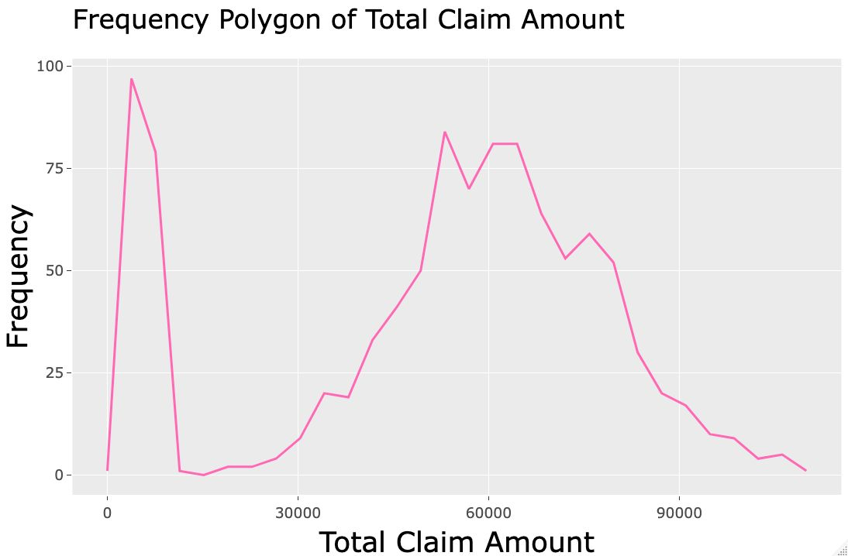
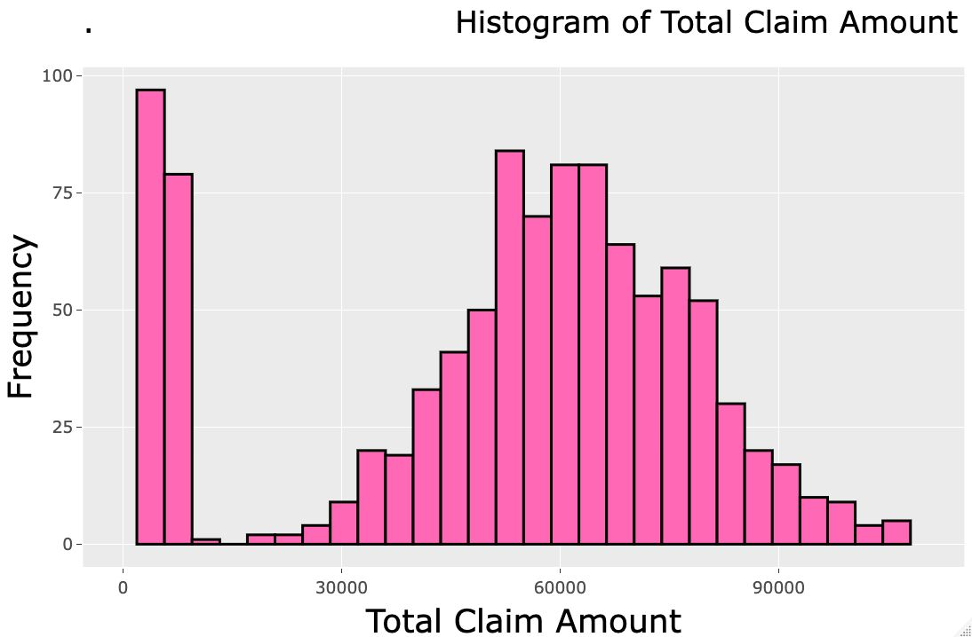
EDA
Total Claim Amount
Mixture exists

Slide 12

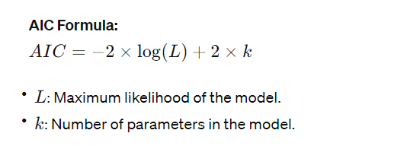
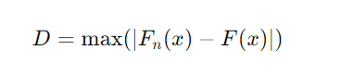
Methodology
Parameter Estimation
Alogrithm
There are many algorithms available however literature suggests that EM algorithm has been the most widely used for mixture distributions for its accuracy
Goodness of Fit
The Kolmogorov–Smirnov statistic quantifies a distance between the empirical distribution function of the sample and the cumulative distribution function of the reference distribution, or between the empirical distribution functions of two samples.
H0: The sample is drawn from the reference distribution.
H1: The sample is not drawn from the reference distribution.
AIC
Score 2
AIC Score 1
KS Test Statistic
Akaike Information Criterion ( AIC) is a single number score that can be used to determine which of multiple models is most likely to be the best model for a given data set. It estimates models relatively.

Slide 13
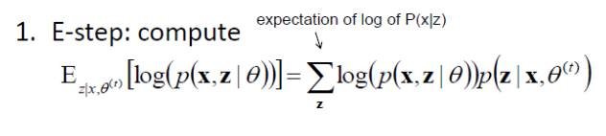
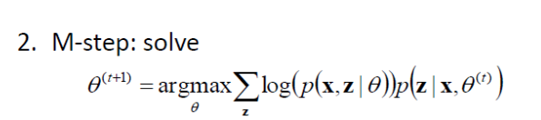
Methodology
EM algorithm
The EM is an iterative process which implies that it will repeatedly cycle between E and M step until the convergence of local optimum, so this type of approach allows the algorithm to gradually improve the estimates of the model parameters.
AIC is a single number score that can be used to determine which of multiple models is most likely to be the best model for a given data set. It estimates models relatively.

Slide 14
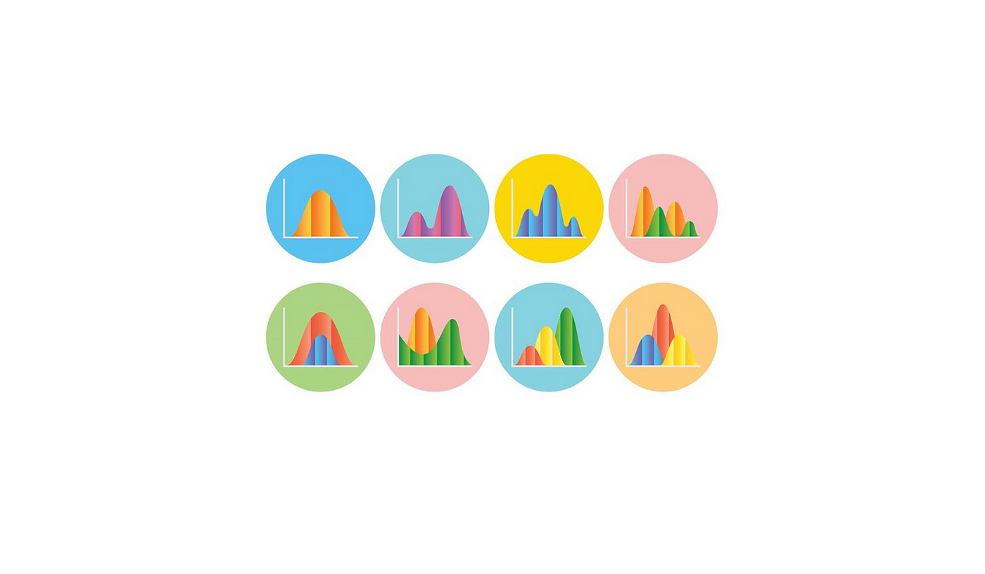
Distributions Investigated
Theory suggests that claim amount data will tend to
follow distributions that are positively skewed
Gamma
Gamma
Lognormal
Lognormal
Weibull
Weibull
Weibull
Normal
Normal

Slide 15
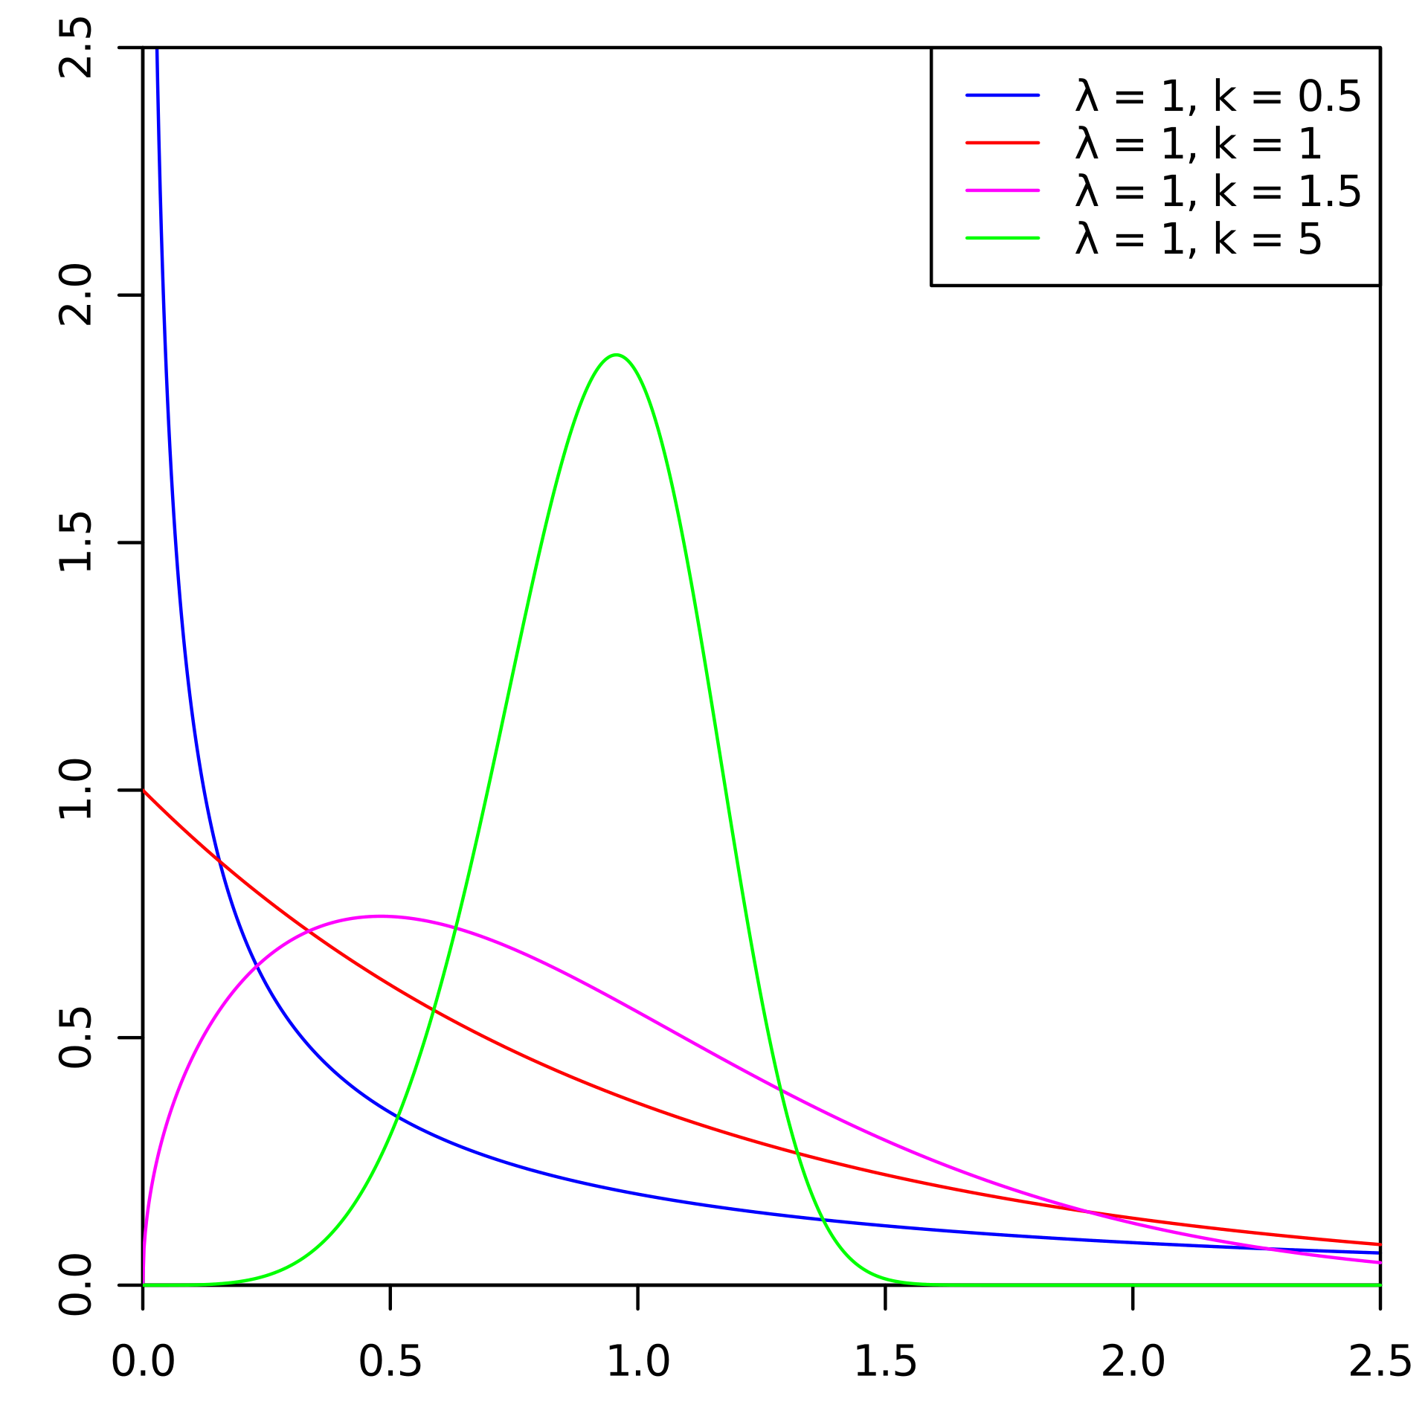
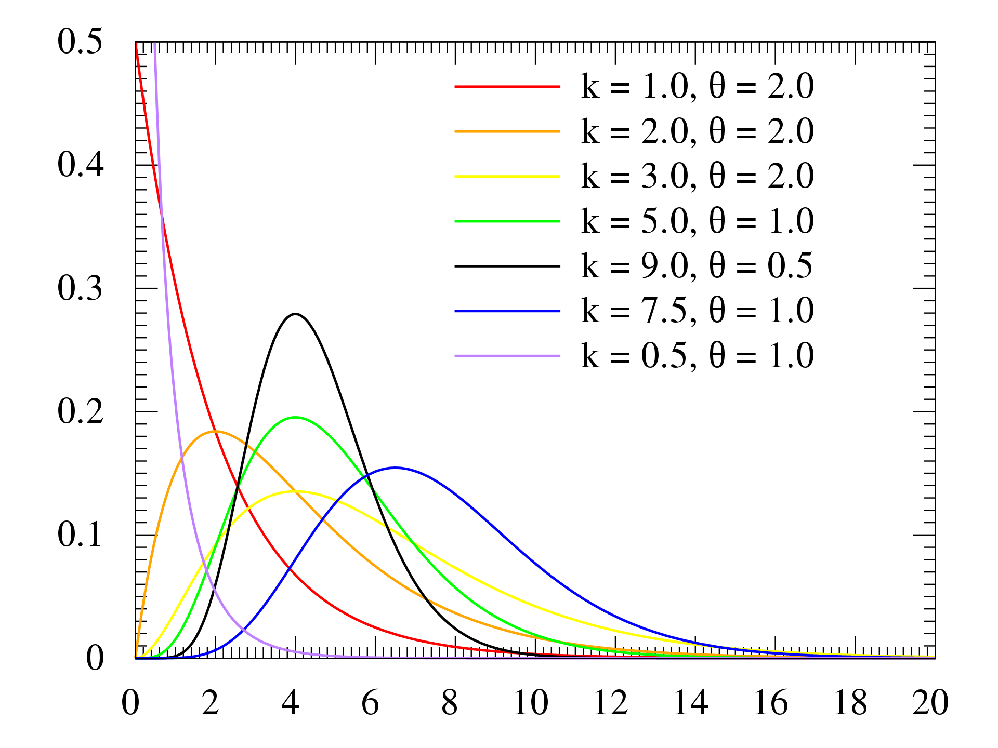
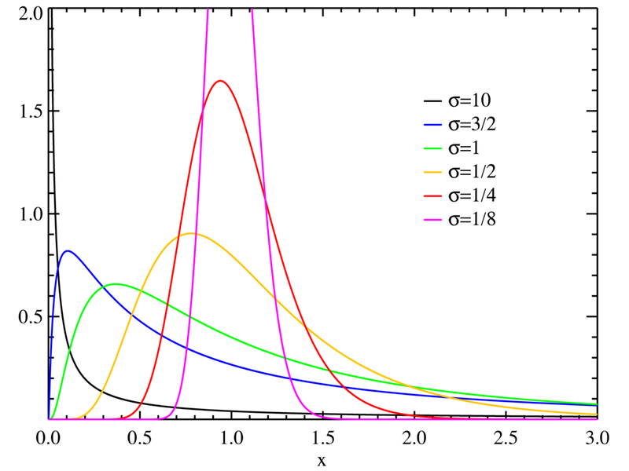
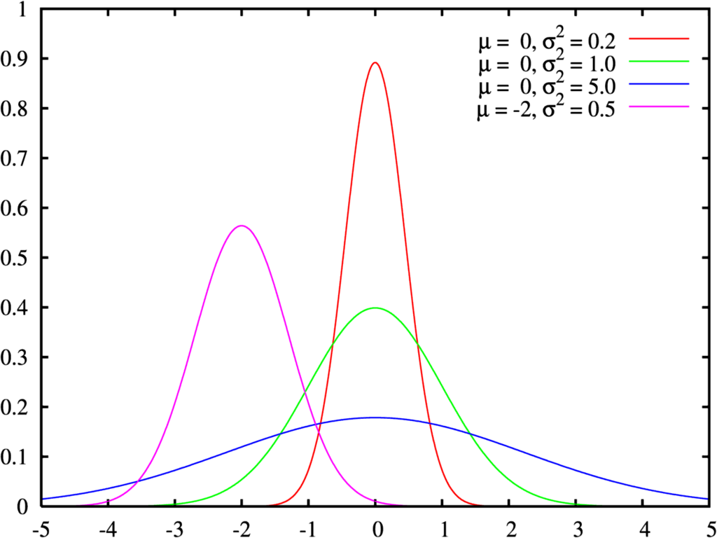
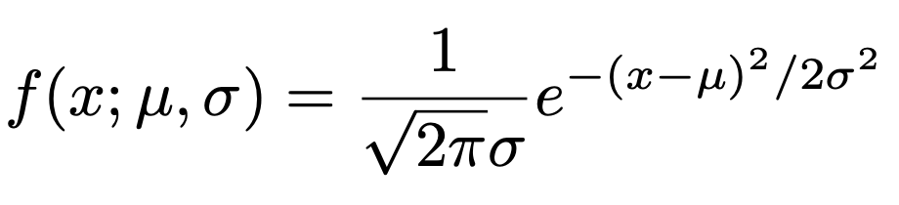
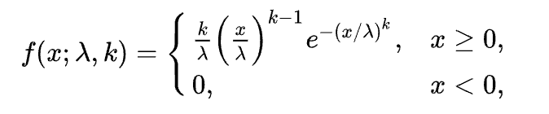
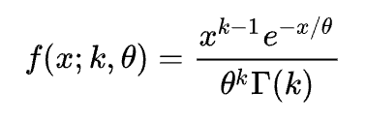
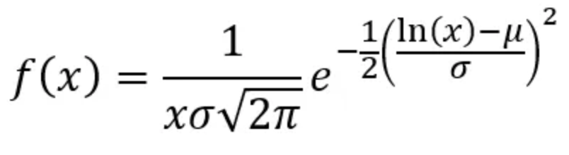
Distributions Investigated
Normal
Weibull
Gamma
Lognormal
x ∈R
μ ∈R
σ²∈R
x>0
θ>0 scale parameter
k>0 shape parameter
μ ∈R
σ>0
k > 0 shape parameter
λ > 0 scale parameter

Slide 16
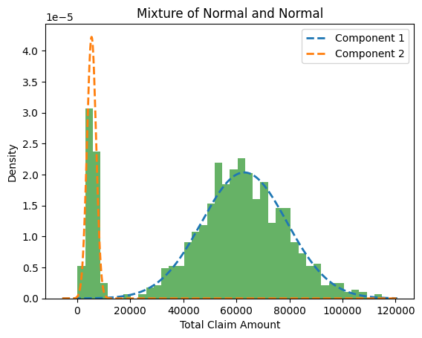
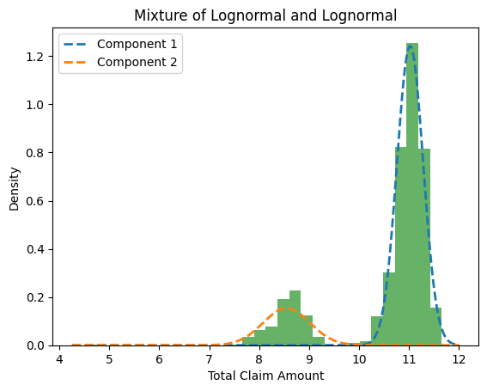
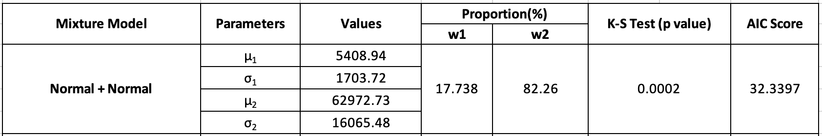
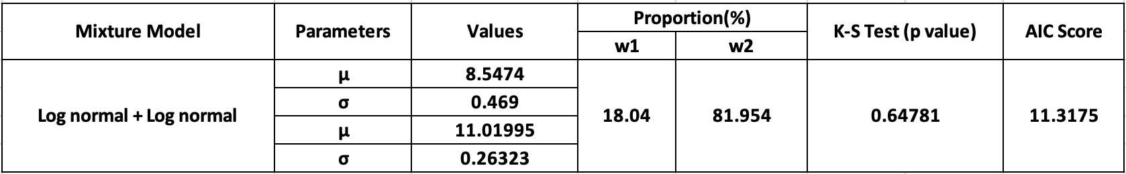
Fitted Distributions
Package used: gmm (Python)
Package used: gmm (Python)

Slide 17
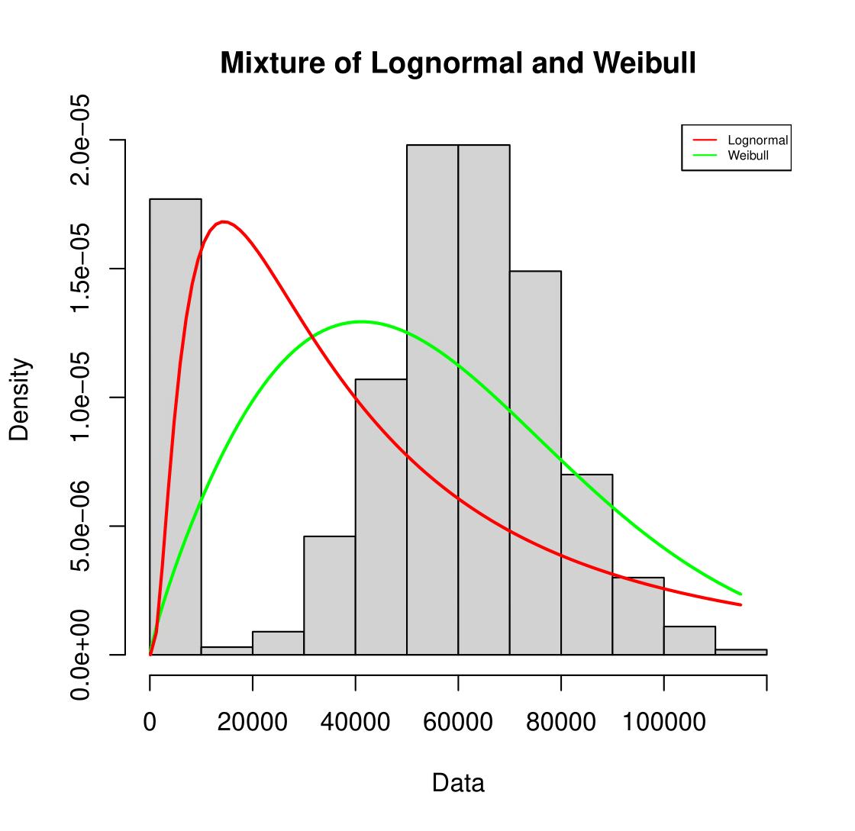
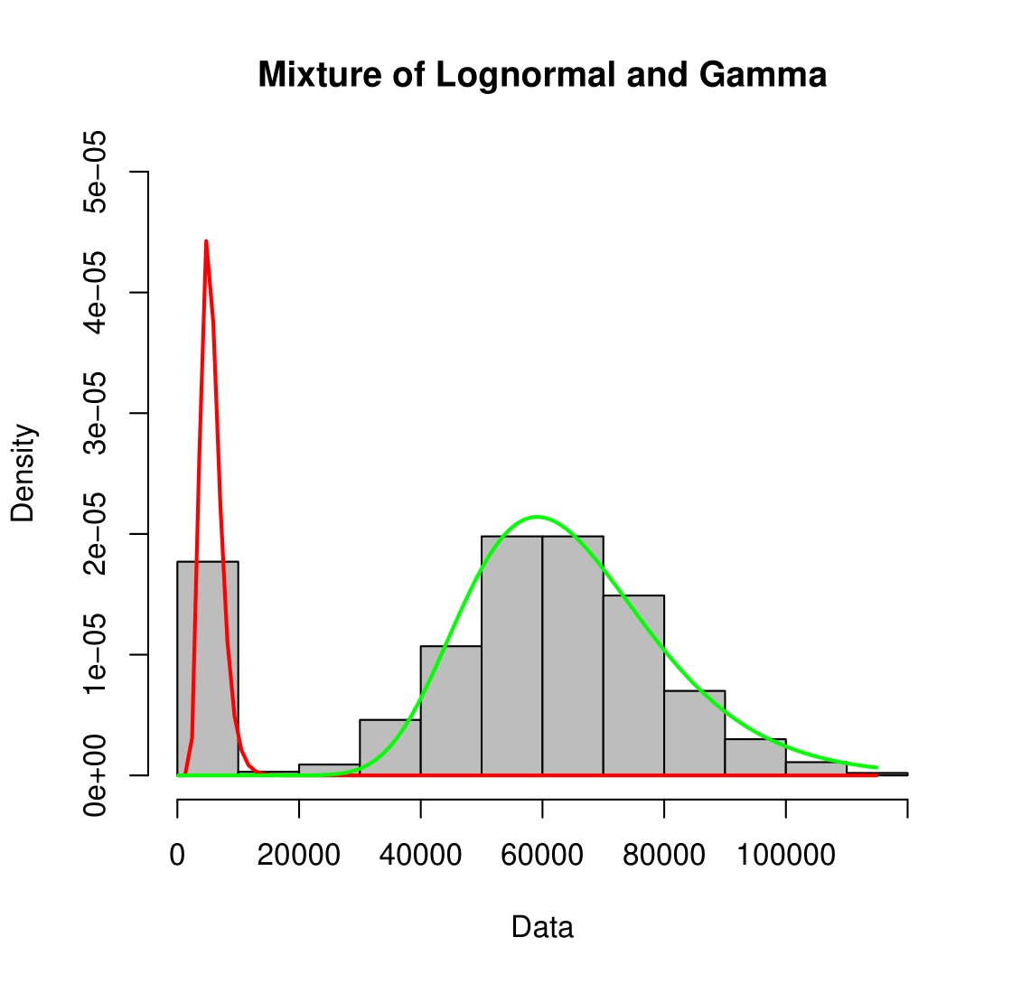
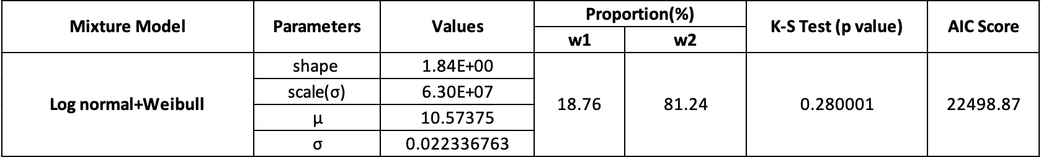
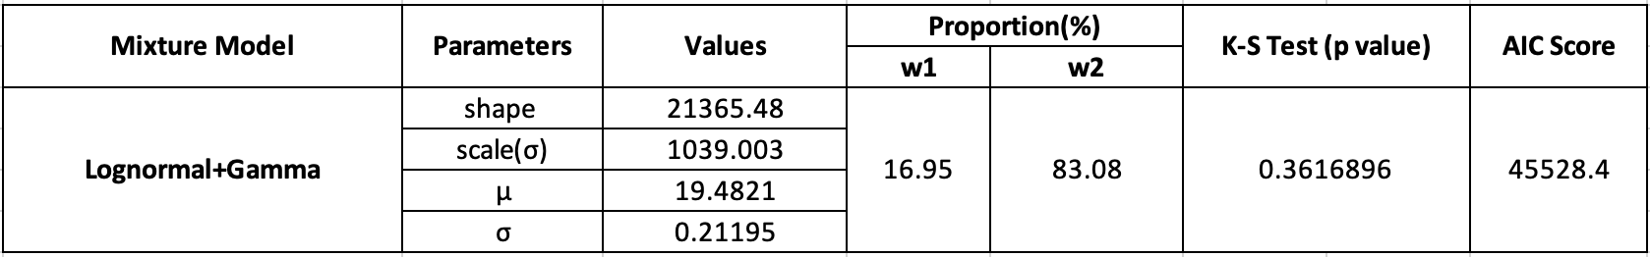
Fitted Distributions
Package used: mixtools, Fitdistr ,normlmixEM
Package used: mixtools, Fitdistr ,normlmixEM

Slide 18
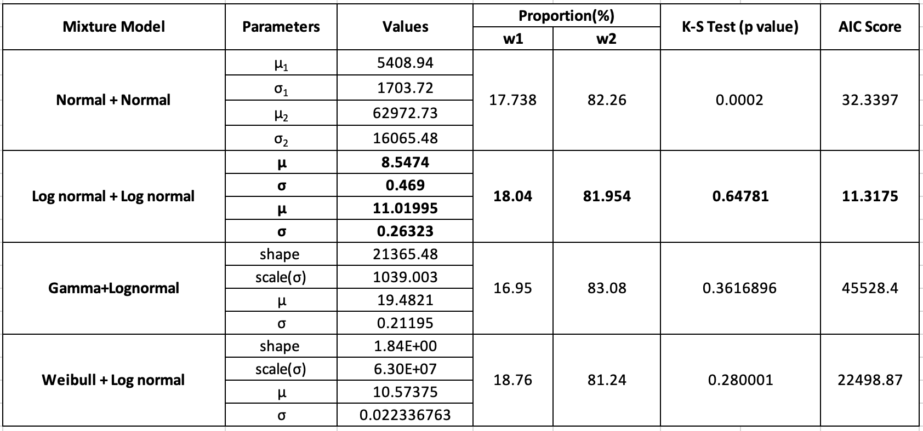
Estimation Results

Slide 19
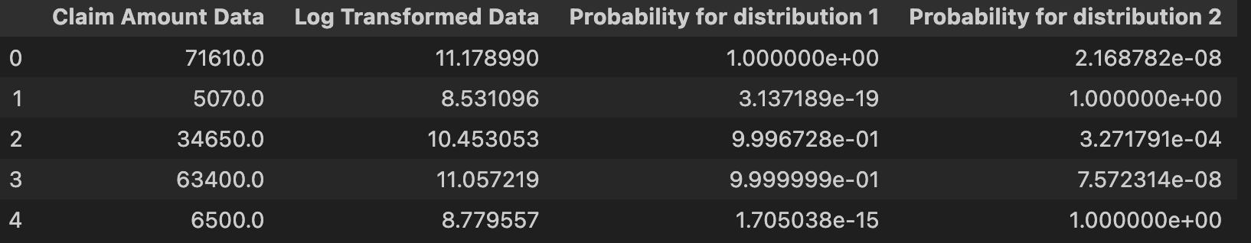
Mixture of LogNormals
Gmm model in python X~LogNormal
Y follows lognormal
82%
18%
μ1=11.0199
σ2=0.0692931
μ2=8.547433
σ2=0.22011
820 data points
180 data points

Slide 20
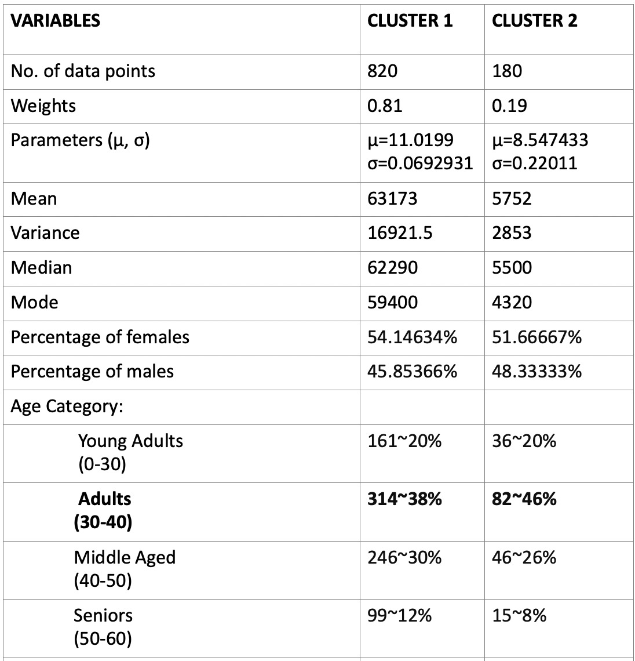
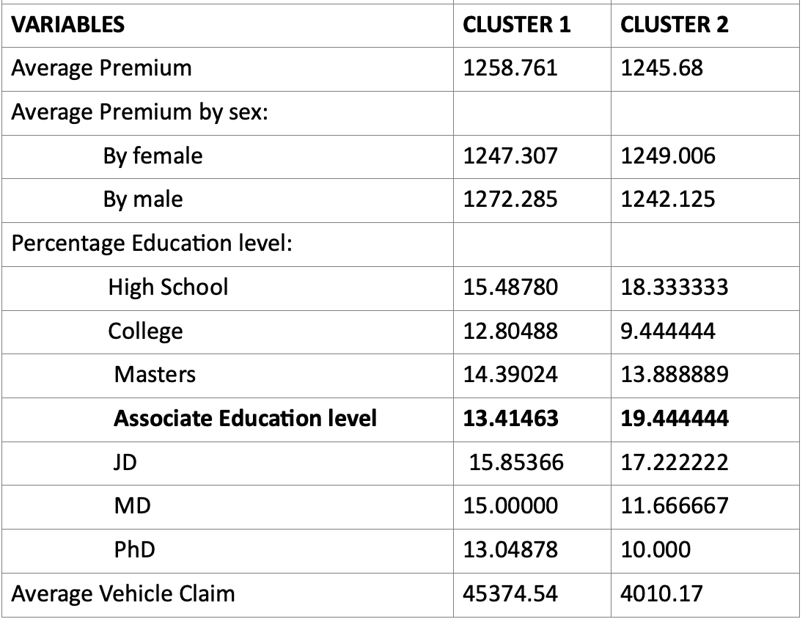
Results
Weighted average claim: $ 52,263.01

Slide 21
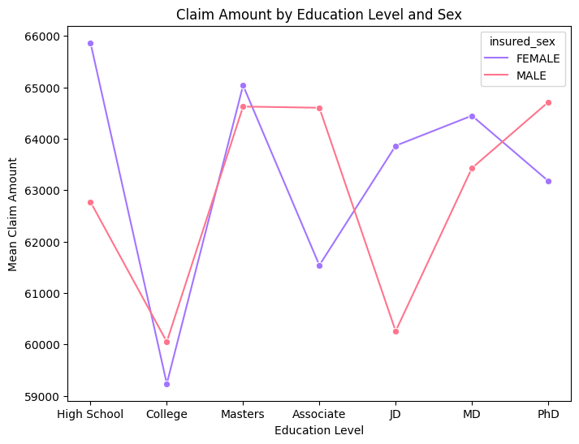
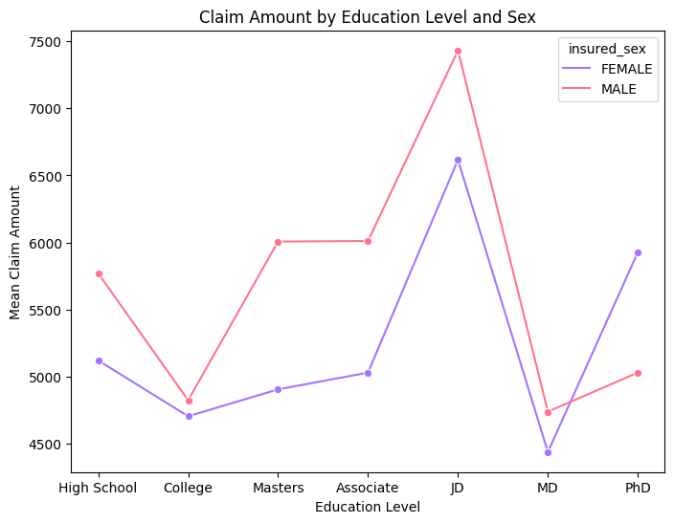
INFERENCES
Cluster 1
Cluster 2
Insurance claim amounts are predominantly made by females in high school.
Males Master’s, PhD degrees are likely to claim higher amount than females.
Individuals holding a Professional degree, are likely to claim higher amount regardless of gender.
Males with a Ph.D. degree and females with an MD degree appear to claim lesser amount

Slide 22
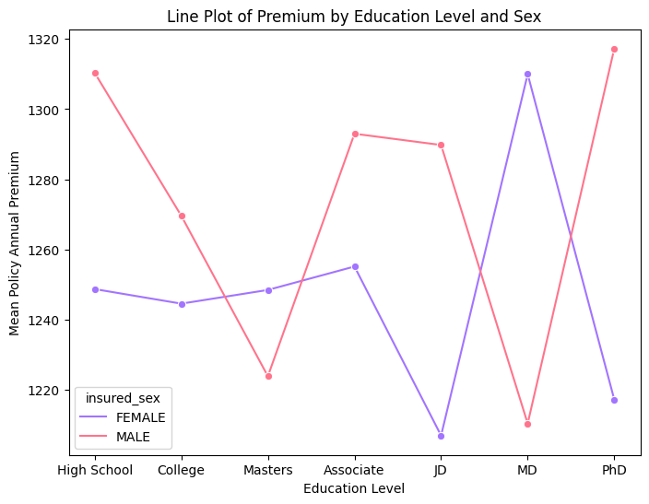
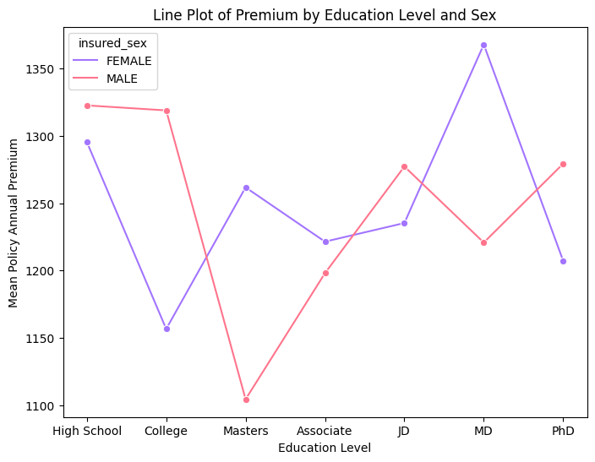
INFERENCES
Cluster 1
Cluster 2
High school males and males with associate and working professional ,PhD degrees are likely to go for higher premium.
Females with MD degree go for higher premium.
Males with PhD degree are likely to go for higher premium and with Master’s degree are likely to go for lesser premium.
Females with MD and Master’s degree go for higher premium.

Slide 23
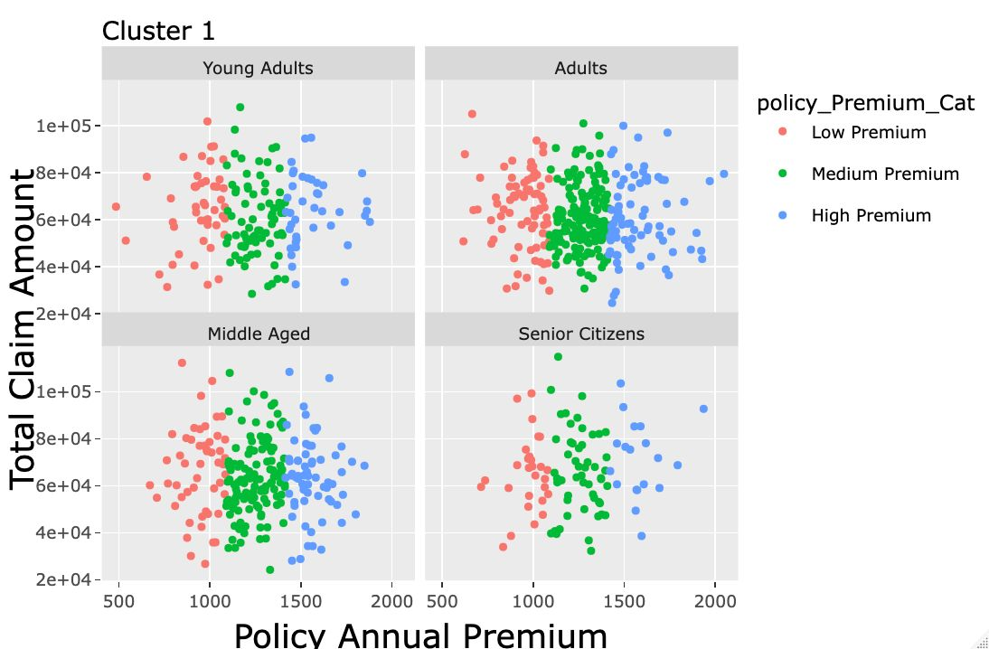
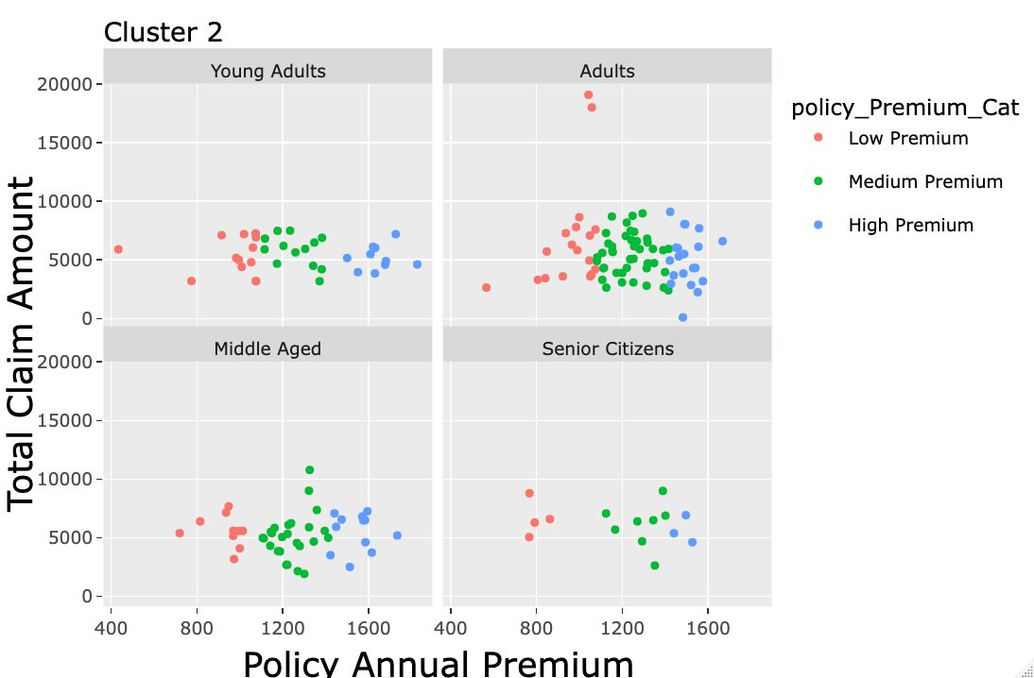
For cluster 1 we observe that young adults with lack of knowledge and less spending power tends to choose revolve around any kind of policy plan but incase of middle aged , senior citizens having more spending power and more knowledge about the premium plans they stick with medium and high premium only
For cluster 2 we observe that most of the policy premiums tend to lie around a specific limit of total claim amount which basically means there’s a miniscule change in total claim amount as your premium is increasing

Slide 24
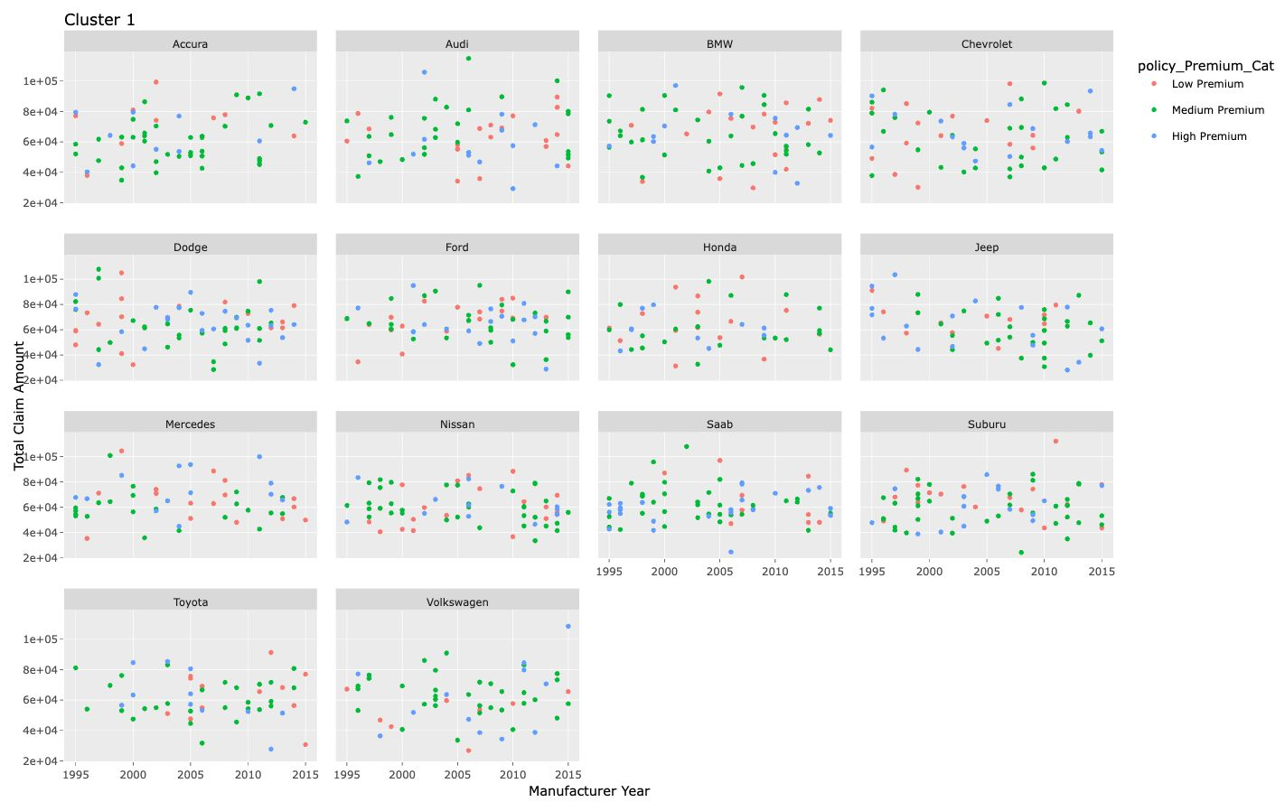
INFERENCES
BEHAVIOUR OF TOTAL CLAIM AMOUNT AND CAR MANUFACTURER FOR PREMIUM CATEGORY

Slide 25
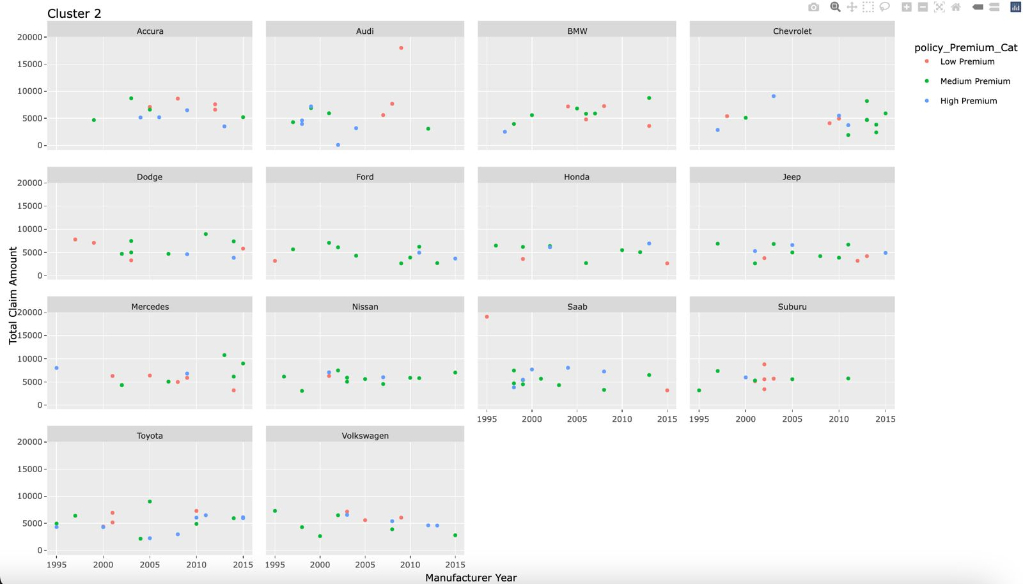
BEHAVIOUR OF TOTAL CLAIM AMOUNT AND CAR MANUFACTURER FOR PREMIUM CATEGORY

Slide 26
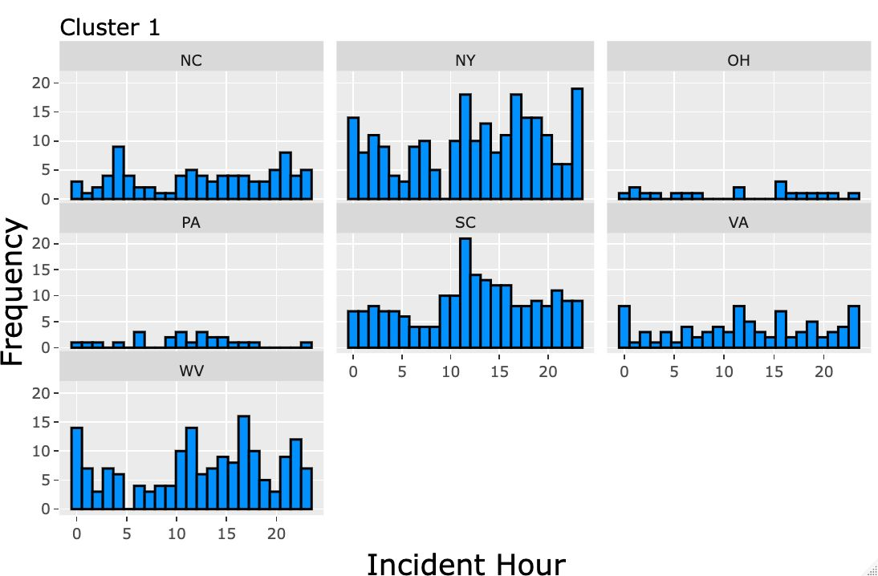
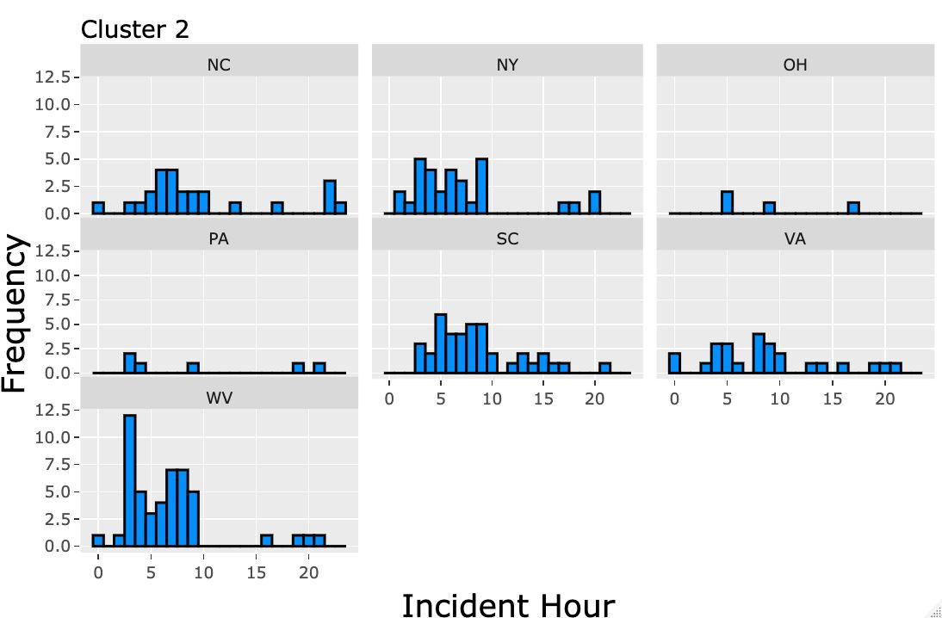
For Cluster 1 we observe that in busy states like NewYork, South Carolina and West Virginia accidents can occur at any given interval of the day with higher frequency
For Cluster 2 we observe that majority of the accidents occur till 10th hour of the day but there’s a miniscule change in frequency as the day progresses

Slide 27
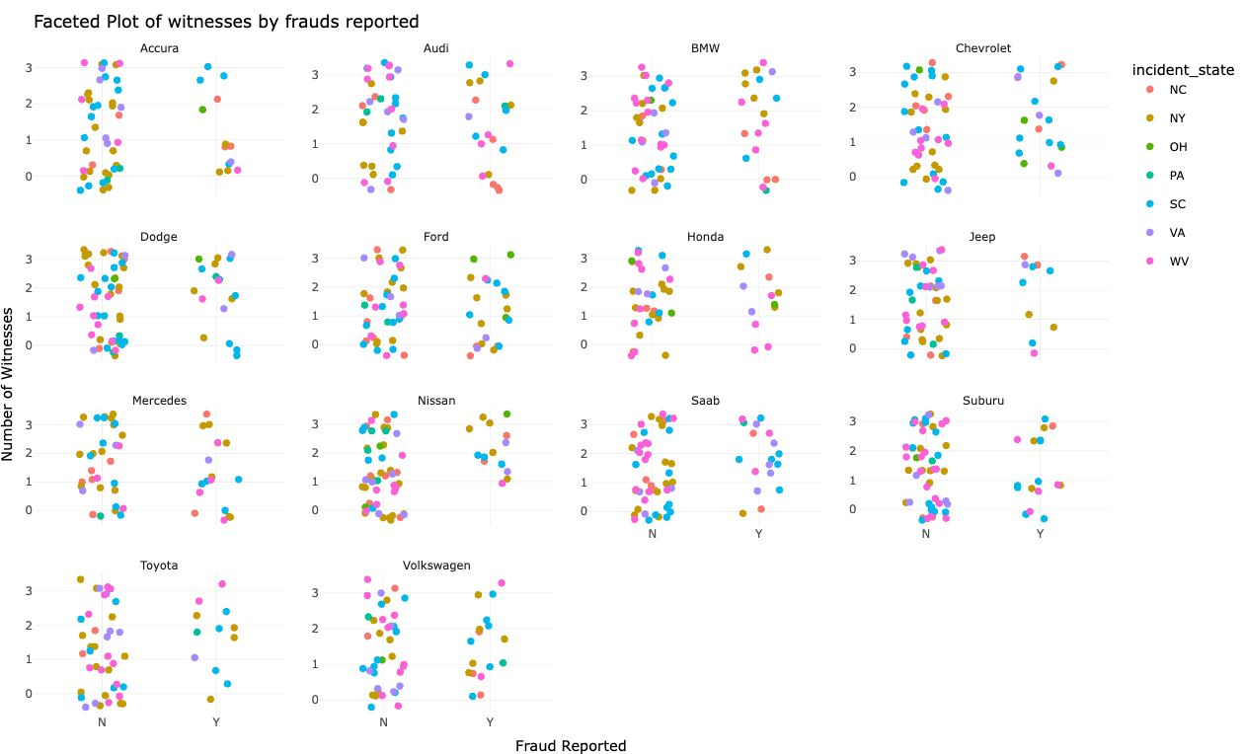
FRAUD REPORTED IN INCIDENT STATES FOR CAR DEALER TYPE

Slide 28
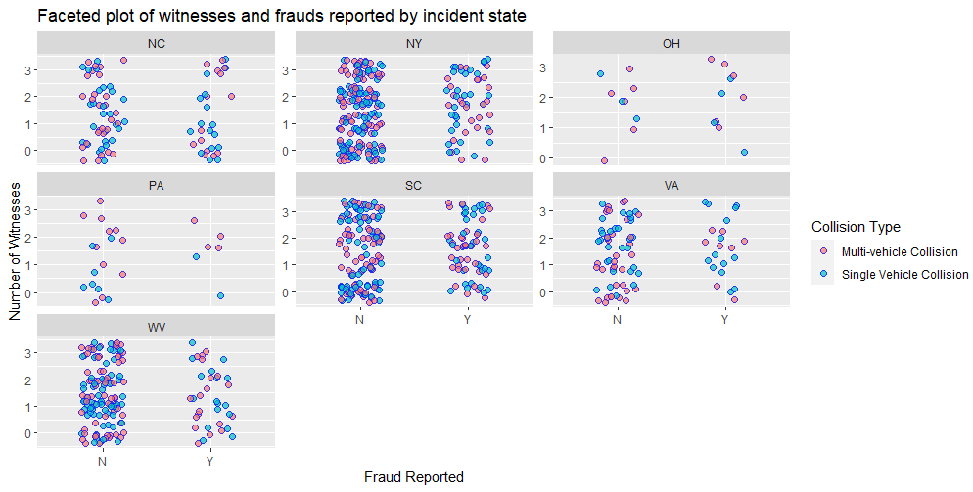
We can comment that in states such as Newyork, South Carolina and Virginia the ratio of fraud not getting committed and fraud getting committed are relatively similar

Slide 29
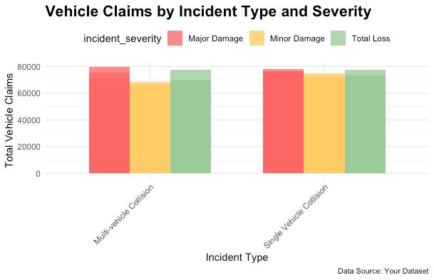
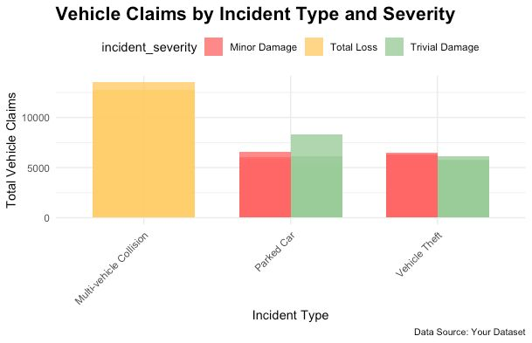
BEHAVIOUR OF TOTAL CLAIM AMOUNT AGAINST INCIDENT TYPE AND SEVERITY

Slide 30

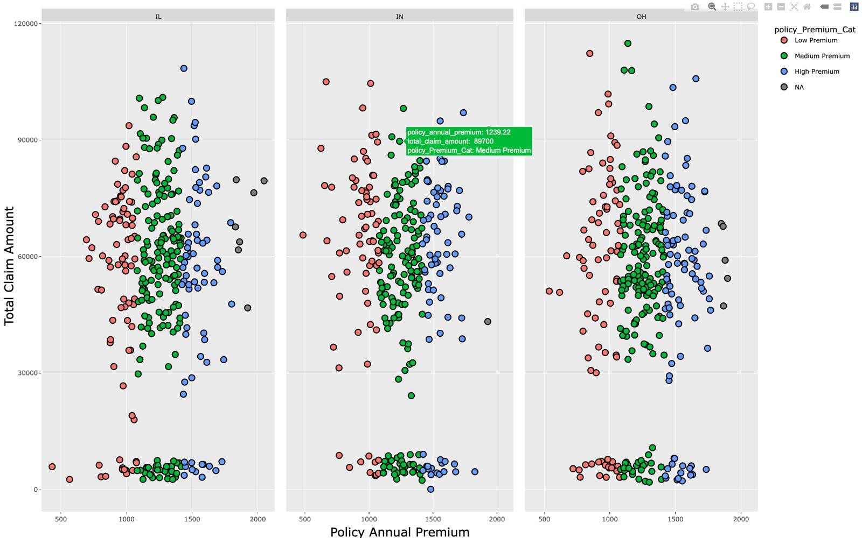
Additional Insights

Slide 31
LIMITATIONS
Data Volume and Computational Complexity:
Estimating the parameters of a mixture distribution, especially with a large number of claims, can be computationally expensive and may pose challenges in terms of processing time and resource requirements.
Number of Components
Choosing too few components may oversimplify the model, failing to capture underlying data structure.
Choosing too many components can lead to overfitting and increased computational complexity.
Identifiability:
Different combinations of component distributions can produce the same overall distribution.
Challenges in interpreting parameters and estimating the true underlying distribution.
Initialization Sensitivity:
In EM algorithms, Poor initializations may lead to convergence to local optima instead of the global optimum.

Slide 32
FUTURE SCOPE
Mixture distributions can contribute to the development of more dynamic pricing models.
Insurers can adjust premiums in real-time based on changes in the risk profile of policyholders, considering factors such as driving behaviour, environmental conditions, and other relevant variables.
More Distributions and their mixtures can be studied like gamma-gamma, weibull-weibull.

Slide 33

REFERENCES
For EM Algorithm:
https://onlinelibrary.wiley.com/doi/book/10.1002/9780470191613
For Mixture Distributions:
https://medium.com/@smallfishbigsea/an-explanation-of-discretized-logistic-mixture-likelihood-bdfe531751f0#:~:text=Mixture%20of%20Distributions&text=A%20mixture%20of%20distriction%20is,power%20by%20introducing%20more%20parameters.
For Lognormal Distributions:
https://www.sciencedirect.com/science/article/abs/pii/S2211692318300663

Slide 34
Thank you!
THANK YOU !

